Slide 1
Module 5 Advanced Topics in Cloud Computing
Energy Efficiency in Clouds, Market Based Management of Clouds

Slide 2
Data Center Power Consumption
Data Center energy demand doubles every 5-6 years.
This results in large amounts of CO2 produced by burning fossil fuels.
Need to reduce the energy used with minimal performance impact.
Ref: Efficient Resource Management for Cloud Computing Environments, by Andrew J. Younge, Gregor von Laszewski, Lizhe Wang, Sonia Lopez-Alarcon, Warren Carithers

Slide 3
Datacenters are new Polluters
U.S. data centers are using more electricity than they need. It takes 34 power plants, each capable of generating 500 megawatts of electricity, to power all the data centers in operation today.(2017)

Slide 4
Datacenters are new Polluters
By 2020, the nation will need another 17 similarly sized power plants to meet projected data center energy demands as economic activity becomes increasingly digital.

Slide 5
Datacenters are new Polluters
Any increase in the use of fossil fuels to generate electricity will result in an increase in carbon emissions.

Slide 6
Fossil Fuels?

Slide 7
What are Fossil Fuels?
Formed over millions of years from the fossils, or remains, of dead animals and plants that were buried under dirt and rock.
Heat from inside the earth and pressure from dirt and rock changes these fossils into oil, natural gas and coal.

Slide 8
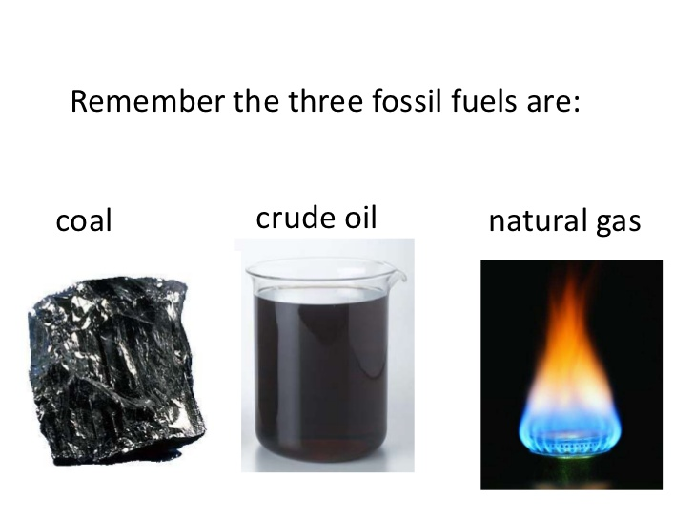
What are Fossil Fuels?
There are three major forms of fossil fuels:
coal
oil
natural gas.
All three were formed many millions of years ago during the time of the dinosaurs.

Slide 9
Why are Fossil Fuels IMP?

Slide 10
Why are Fossil Fuels IMP?
Because it takes
millions of years to make or “renew” more fossil fuels, we call them “nonrenewable fuels.”
We are currently using the fuels that were made more than 65 million years ago.
Once this fuel is gone, it is gone.

Slide 11
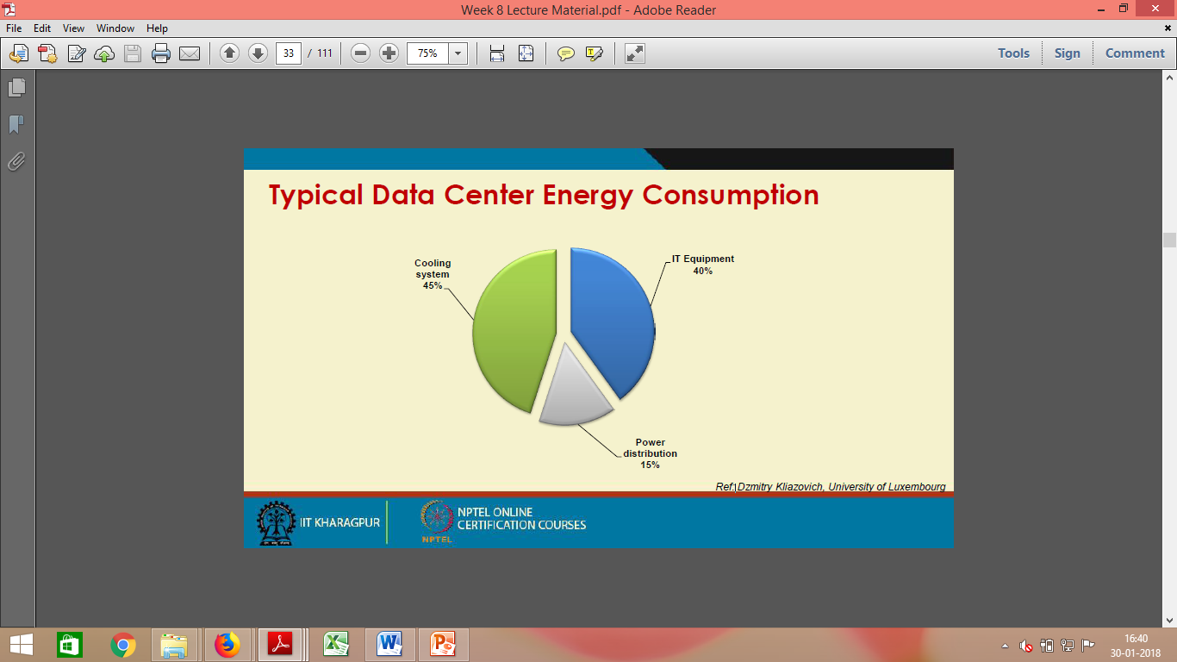
Typical Data Center Energy Consumption
Ref: Dzmitry Kliazovich, University of Luxembourg

Slide 12
Impact of Cloud DC on Environment
Data centers are not only expensive to maintain, but also unfriendly to the environment.
Carbon emission due to Data Centers worldwide are now more than both Argentina and the Netherlands emission.

Slide 13
Impact of Cloud DC on Environment
High energy costs and huge carbon footprints are incurred
due to the massive amount of electricity needed to power and
cool the numerous servers hosted in these data centers.

Slide 14
Impact of Cloud DC on Environment
According to the McKinsey report on “Revolutionizing Data Center Energy Efficiency”, a typical datacenter consumes as much energy as 25,000 households.

Slide 15
Warehouse-Scale Data-Center Design
Data-Center Construction Requirements
Cooling System of a Data-Center Room

Slide 16
Data-Center Construction Requirements
Most data centers are built with commercially available components.
An off-the-shelf server consists of :
a number of processor sockets,
each with a multicore CPU and
its internal cache hierarchy,
local shared and coherent DRAM,
a number of directly attached disk drives.
Off the shelf-not designed or made to order but taken from existing stock or supplies.

Slide 17
Data-Center Construction Requirements
The DRAM and disk resources within the rack are accessible
through first-level rack switches and
all resources in all racks are accessible via a cluster-level switch
Consider a data center
built with 2,000 servers,
each with 8 GB of DRAM and
four 1 TB disk drives.
Each group of 40 servers is connected through a 1 Gbps link to a rack-level switch
Each Rack switch has an additional eight 1 Gbps ports used for connecting the rack to the cluster-level switch.

Slide 18
Cooling System of a Data-Center Room
The Figure shows the layout and cooling facility of a warehouse in a data center.
The data-center room has raised floors for hiding cables, power lines, and cooling supplies.

Slide 19
Cooling System of a Data-Center Room
The raised floor has a steel grid resting on stanchions about 2–4 ft above the concrete floor.
The under-floor area is often used to route power cables to racks, but its primary use is to distribute cool air to the server rack.
Stanchion-frame/fixture to support other object

Slide 20
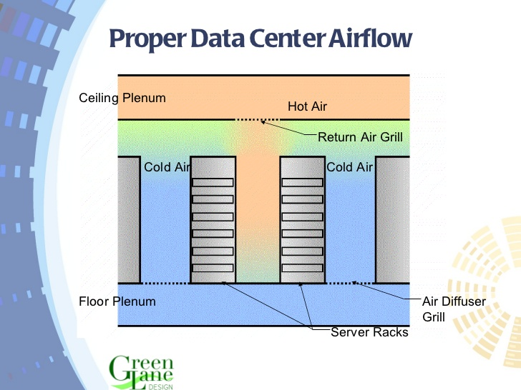
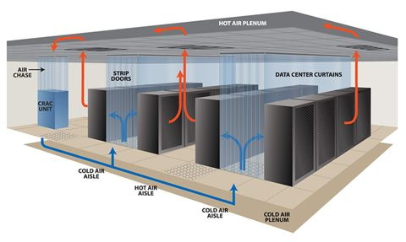
Cooling System of a Data-Center Room
The CRAC (computer room air conditioning) unit pressurizes the raised floor plenum by blowing cold air into the plenum.
The cold air escapes from the plenum through perforated tiles that are placed in front of server racks.

Slide 21
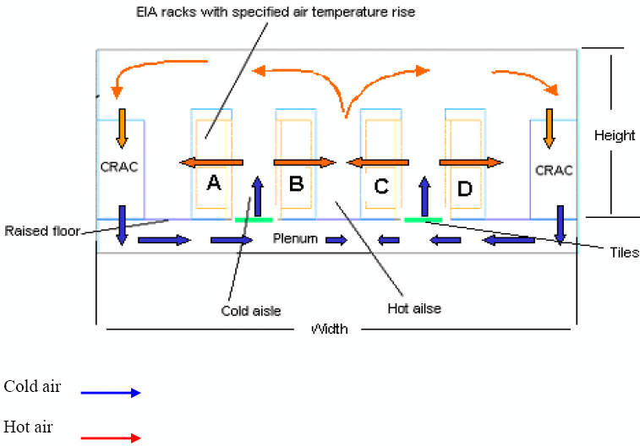
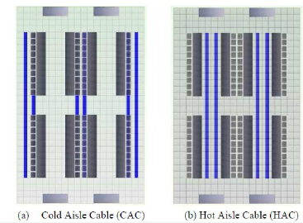
Cooling System of a Data-Center Room
Racks are arranged in long aisles that alternate between cold aisles and hot aisles to avoid mixing hot and cold air.

Slide 22
Cooling System of a Data-Center Room
The hot air produced by the servers circulates back to the intakes of the CRAC units that cool it and then exhaust the cool air into the raised floor plenum again.
Typically, the incoming coolant is at 12–14°C and the warm coolant returns to a chiller.

Slide 23
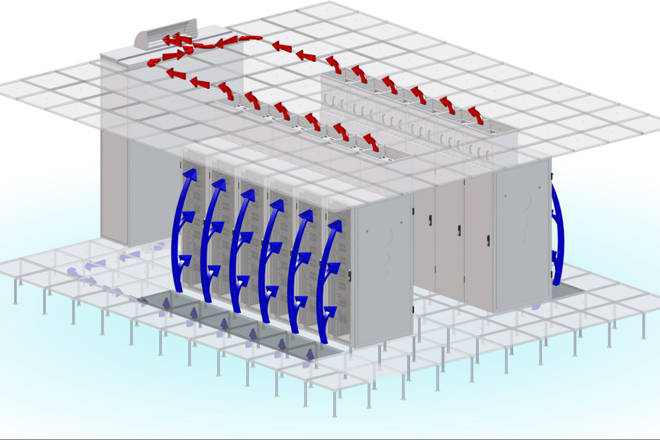
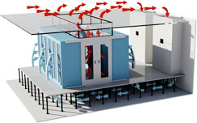
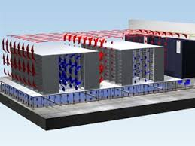
Cooling System of a Data-Center Room

Slide 24
Green Computing ?
Advanced scheduling schemas to reduce energy consumption.
Power aware
Thermal aware
Data center designs to reduce Power Usage.
Cooling systems
Rack design

Slide 25
Performance <-> Energy Efficiency
There is a need to shift focus from optimizing data center resource management for pure performance alone to
optimizing for energy efficiency while maintaining high service level performance.

Slide 26
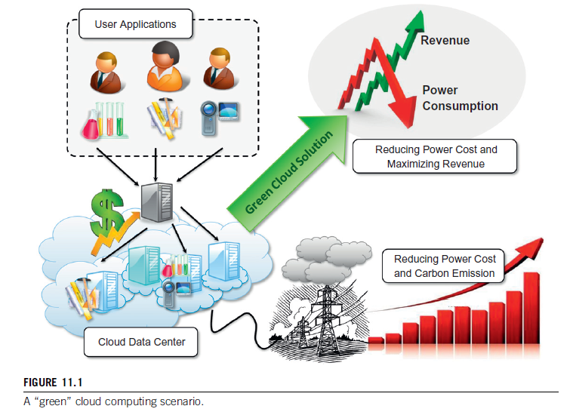
Energy efficiency in clouds
Cloud service providers need to adopt measures to ensure that their profit margins are not dramatically reduced due to high energy costs.

Slide 27
Energy efficiency in clouds
According to Amazon’s estimate,
the energy- related costs of its datacenters amount to 42% of the total budget,
which includes both direct power consumption and the cooling infrastructure amortized over a 15-year period.
As a result, companies such as Google, Microsoft, and Yahoo! are building large datacenters in barren desert land surrounding the Columbia River in the United States to exploit cheap hydroelectric power.

Slide 28
Energy efficiency in clouds
There is also increasing pressure from governments worldwide to reduce carbon footprints, which have a significant impact on climate change.
To address these concerns, leading IT vendors have recently formed a global consortium, called The Green Grid, to promote energy efficiency for datacenters and minimize their impact on the environment

Slide 29
Energy efficiency in clouds
Green cloud computing is envisioned to achieve not only efficient processing and utilization of computing infrastructure but also minimize energy consumption. This is essential for ensuring that the future growth of cloud computing is sustainable
Cloud resources need to be allocated not only to satisfy QoS requirements specified by users via service-level agreements (SLAs) but also to reduce energy usage.

Slide 30
Energy Consumption of Unused Servers
To run a server farm (data center) a company has to spend a huge amount of money for hardware, software, operational support, and energy every year.
Companies should thoroughly identify whether their installed server farm are appropriately utilized.

Slide 31
Energy Consumption of Unused Servers
STats
On average, one-sixth (15 percent) of the full-time servers in a company are left powered on without being actively used (i.e., they are idling) on a daily basis.
This indicates that with 44 million servers in the world, around 4.7 million servers are not doing any useful work.
The potential savings in turning off these servers are large.
IT departments need to analyze their servers and find out unused or underutilized servers.

Slide 32
Reducing Energy in Active Servers
Apply appropriate techniques to decrease energy consumption in active distributed systems with negligible influence on their performance.
Power management issues in distributed computing platforms can be categorized into four layers:
application layer
middleware layer
resource layer
network layer.

Slide 33
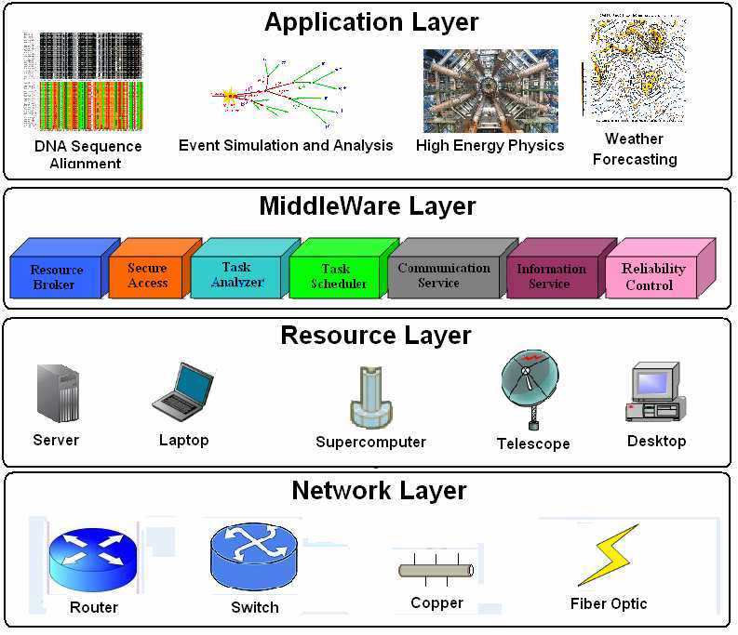

Slide 34
Application Layer
An application’s energy consumption depends strongly on:
no of instructions needed to execute the application
no of transactions with the storage unit (or memory).
These two factors (compute and storage) are correlated and they affect completion time.

Slide 35
Application Layer
By introducing energy-aware applications, the challenge is to design applications without hurting performance.
The first step is-
“To explore a relationship between performance and energy consumption”.

Slide 36
Middleware Layer
Bridge between Application Layer and the resource layer.
This Layer provides:
Resource broker
Communication service
Task analyzer
Task scheduler
Security access
Reliability control
Information Service

Slide 37
Middleware Layer
Necessity of a new cost function covering both
makespan i.e. the execution time of a set of tasks and
energy consumption.

Slide 38
Resource Layer
Consists of a wide range of resources including
computing nodes and
storage units.
Interacts with hardware devices and the operating system.
Several mechanisms have been developed for
more efficient power management of hardware and operating systems.

Slide 39
Resource Layer
Hardware Approaches:-
Dynamic power management (DPM)
Dynamic voltage-frequency scaling (DVFS)
Popular methods incorporated into recent computer hardware systems.

Slide 40
Resource Layer- DPM
Dynamic power management (DPM)
In DPM, hardware devices, such as the CPU, have the capability to-
“Switch from idle mode to one or more lower power modes”

Slide 41
Resource Layer- DVFS
Dynamic voltage-frequency scaling (DVFS)
In DVFS, energy savings are achieved based on the fact that the power consumption in CMOS circuits has a direct relationship with frequency and the square of the voltage supply.

Slide 42
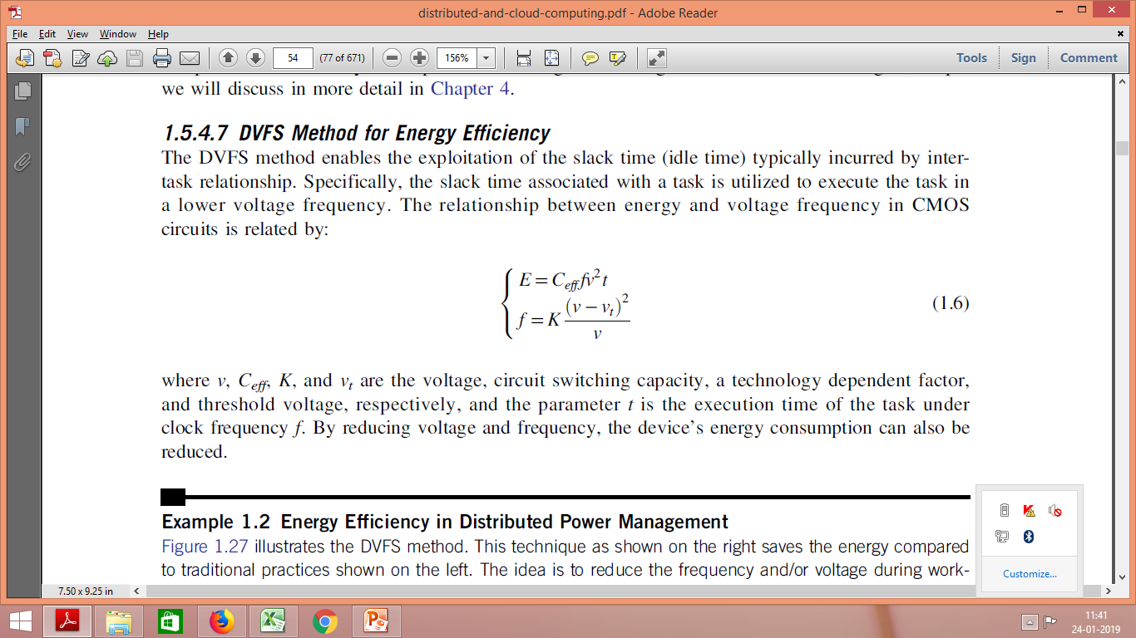
Resource Layer- DVFS
The relationship between energy ,voltage ,frequency in CMOS circuits is related by:
where
V= voltage
Ceff= circuit switching capacity
K= a technology dependent factor
Vt= threshold voltage
T= execution time of the task under clock frequency f.

Slide 43
Resource Layer- DVFS
Execution time and power consumption are controllable by-
“Switching among different frequencies and voltages”

Slide 44
DVFS
The DVFS method enables the exploitation of the slack time (idle time) typically incurred by intertask relationship.
Reducing the frequency or voltage during slack time.
By reducing voltage and frequency, the device’s energy consumption can also be reduced.

Slide 45
Network Layer
Routing and transferring packets
Enabling network services to the resource layer are the main responsibility of the network layer in Distributed Computing Systems.

Slide 46
Network Layer
Two major challenges are :
New, energy-efficient routing algorithms need to be developed.
New, energy-efficient protocols should be developed against network attacks.

Slide 47
A reference model for MOCC
Market-oriented cloud computing originated from the coordination of several components:
service consumers,
service providers, and
other entities that make trading between these two groups possible.

Slide 48
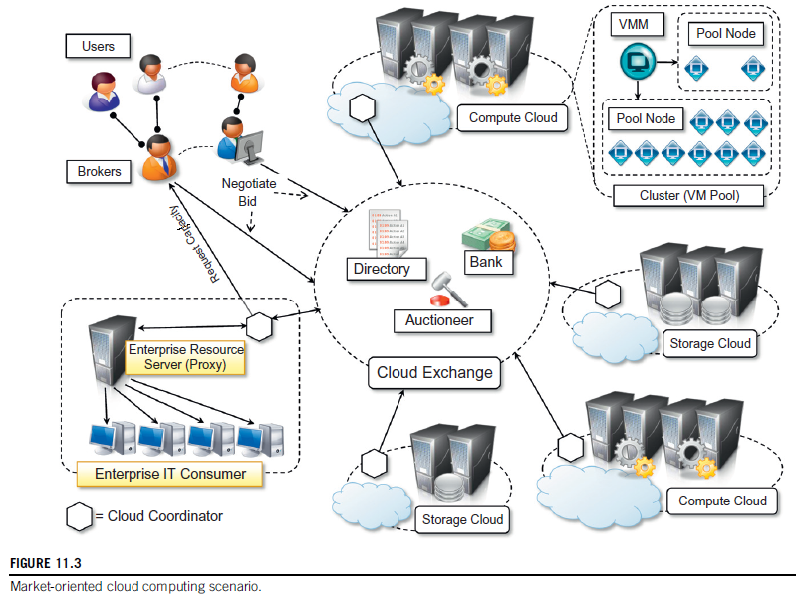
A reference model for MOCC
Several components contribute to the realization of the Cloud Exchange and implement its features.

Slide 49
A reference model for MOCC
Directory:-
The market directory contains a listing of all the published services that are available
The directory not only contains a simple mapping between service Names and the corresponding vendor (or cloud coordinators) offering them.

Slide 50
A reference model for MOCC
Directory:-
It also provides Additional meta data that can help the brokers or the end users in filtering from among the services of interest those that can really meet the expected quality of service.

Slide 51
A reference model for MOCC
Auctioneer
The auctioneer is incharge of keeping track of the running auctions in the market place and of verifying that the auctions for services are properly conducted and that malicious market players are prevented from performing illegal activities

Slide 52
A reference model for MOCC
Bank
The bank is the component that takes care of the financial aspect of all the operations happening in the virtual marketplace.
It also ensures that all the financial transactions are carried out in a secure and dependable environment.
Consumers and providers may register with the bank and have one or multiple accounts that can be used to perform the transactions in the virtual marketplace

Slide 53
A reference model for MOCC
CEx
The fundamental component is the virtual marketplace—represented by the Cloud Exchange(CEx)—which acts as a market maker, bringing service producers and consumers together.

Slide 54
A reference model for MOCC
Cloud Broker
The cloud brokers operate on behalf of the consumers and identify the subset of services that match customers’ requirements in terms of service profiles and quality of service.

Slide 55
A reference model for MOCC
Cloud Broker
They mediate between coordinators and consumers by acquiring services from the first and subleasing them to the latter.
Brokers can accept requests from many users. At the same time, users can leverage different brokers.

Slide 56
A reference model for MOCC
Cloud Coordinators
The cloud coordinators represent the cloud vendors and publish the services that vendors offer.
A similar relationship can be considered between coordinators and cloud computing services vendors.

Slide 57
A reference model for MOCC
Cloud Coordinators
Coordinators take responsibility for publishing and advertising services on behalf of vendors and can gain benefits from reselling services to brokers.

Slide 58
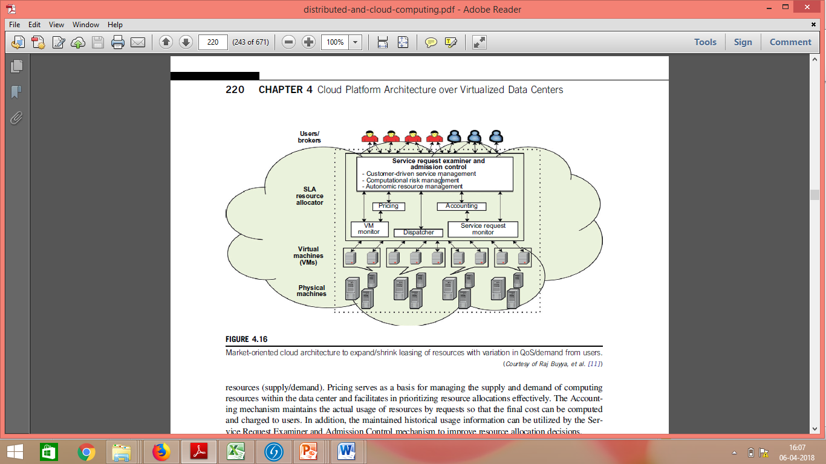
Market-Oriented Cloud Architecture for Data Centers

Slide 59
Market-Oriented Cloud Architecture
As consumers rely on cloud providers to meet more of their computing needs,
they will require a specific level of QoS to be maintained by their providers.
Cloud providers consider and meet the different QoS parameters of each individual consumer as negotiated in specific SLAs.

Slide 60
Market-Oriented Cloud Architecture
The purpose is to promote QoS-based resource allocation mechanisms.
Clients can benefit from the potential cost reduction of providers,
which could lead to a more competitive market,
and thus lower prices.

Slide 61
Market-Oriented Cloud Architecture
Users or brokers acting on user’s behalf submit service requests from anywhere in the world to the data center and cloud to be processed.
They originate the workload that is managed in the cloud datacenter.

Slide 62
Market-Oriented Cloud Architecture
SLA resource allocator-
Acts as the interface between the data center, cloud service provider and external users/brokers.
Its main responsibility is ensuring that service requests are satisfied according to the SLA agreed to with the user.
Several components coordinate allocator activities in order to realize this goal

Slide 63
Market-Oriented Cloud Architecture
Service Request Examiner and Admission Control Module-
When a service request is first submitted
the service request examiner interprets the submitted request for QoS requirements
before determining whether to accept or reject the request.

Slide 64
Market-Oriented Cloud Architecture
Service Request Examiner and Admission Control Module-
This module operates in the front-end and filters user and broker requests in order to accept those that are feasible given the current status of the system and the workload that is already processing.
Accepted requests are allocated and scheduled for execution.

Slide 65
Market-Oriented Cloud Architecture
The Pricing mechanism decides how service requests are charged.
This module is responsible for charging users according to the SLA they signed.
Different parameters can be considered in charging users; for instance, the most common case for IaaS providers is to charge according to the characteristics of the virtual machines requested in terms of memory, disk size, computing capacity, and the time they are used.

Slide 66
Market-Oriented Cloud Architecture
The Accounting mechanism maintains the actual usage of resources by requests so that the final cost can be computed and charged to users.
It stores the billing information for each user.
In addition, they constitute a rich source of information that can be mined to identify usage trends and improve the vendor’s service offering.

Slide 67
Market-Oriented Cloud Architecture
Dispatcher-
This component is responsible for the low-level operations that are required to realize admitted service requests.
The Dispatcher mechanism starts the execution of accepted service requests on allocated VMs.

Slide 68
Market-Oriented Cloud Architecture
Dispatcher-
In an IaaS scenario, this module instructs the infrastructure to deploy as many virtual machines as are needed to satisfy a user’s request.
In a PaaS scenario, this module activates and deploys the user’s application on a selected set of nodes; deployment can happen either within a virtual machine instance or within an appropriate sandboxed environment.

Slide 69
Market-Oriented Cloud Architecture
VM Monitor-
The VM Monitor mechanism keeps track of the availability of VMs and their resource entitlements.
Resource Monitor-
This component monitors the status of the computing resources, either physical or virtual

Slide 70
Market-Oriented Cloud Architecture
The Service Request Monitor mechanism keeps track of the execution progress of service requests.
The information collected through the Service Request Monitor is helpful for analyzing system performance and for providing quality feedback about the provider’s capability to satisfy requests.
Multiple VMs can be started and stopped on demand on a single physical machine.

